Slide 1

Maajii-ojibwemodaa I
Dagwaagig 2026
Gide'inaan

Slide 2
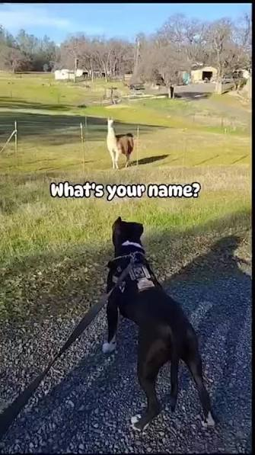
Aaniin ezhinikaazoyan?
Yan
Zoyan
Kaazoyan
Nikaazoyan
Zhinikaazoyan
Ezhinikaazoyan
Aaniin ezhinikaazoyan?
Hint: "ikidodaa" means 'Let's all say it!'

Slide 3
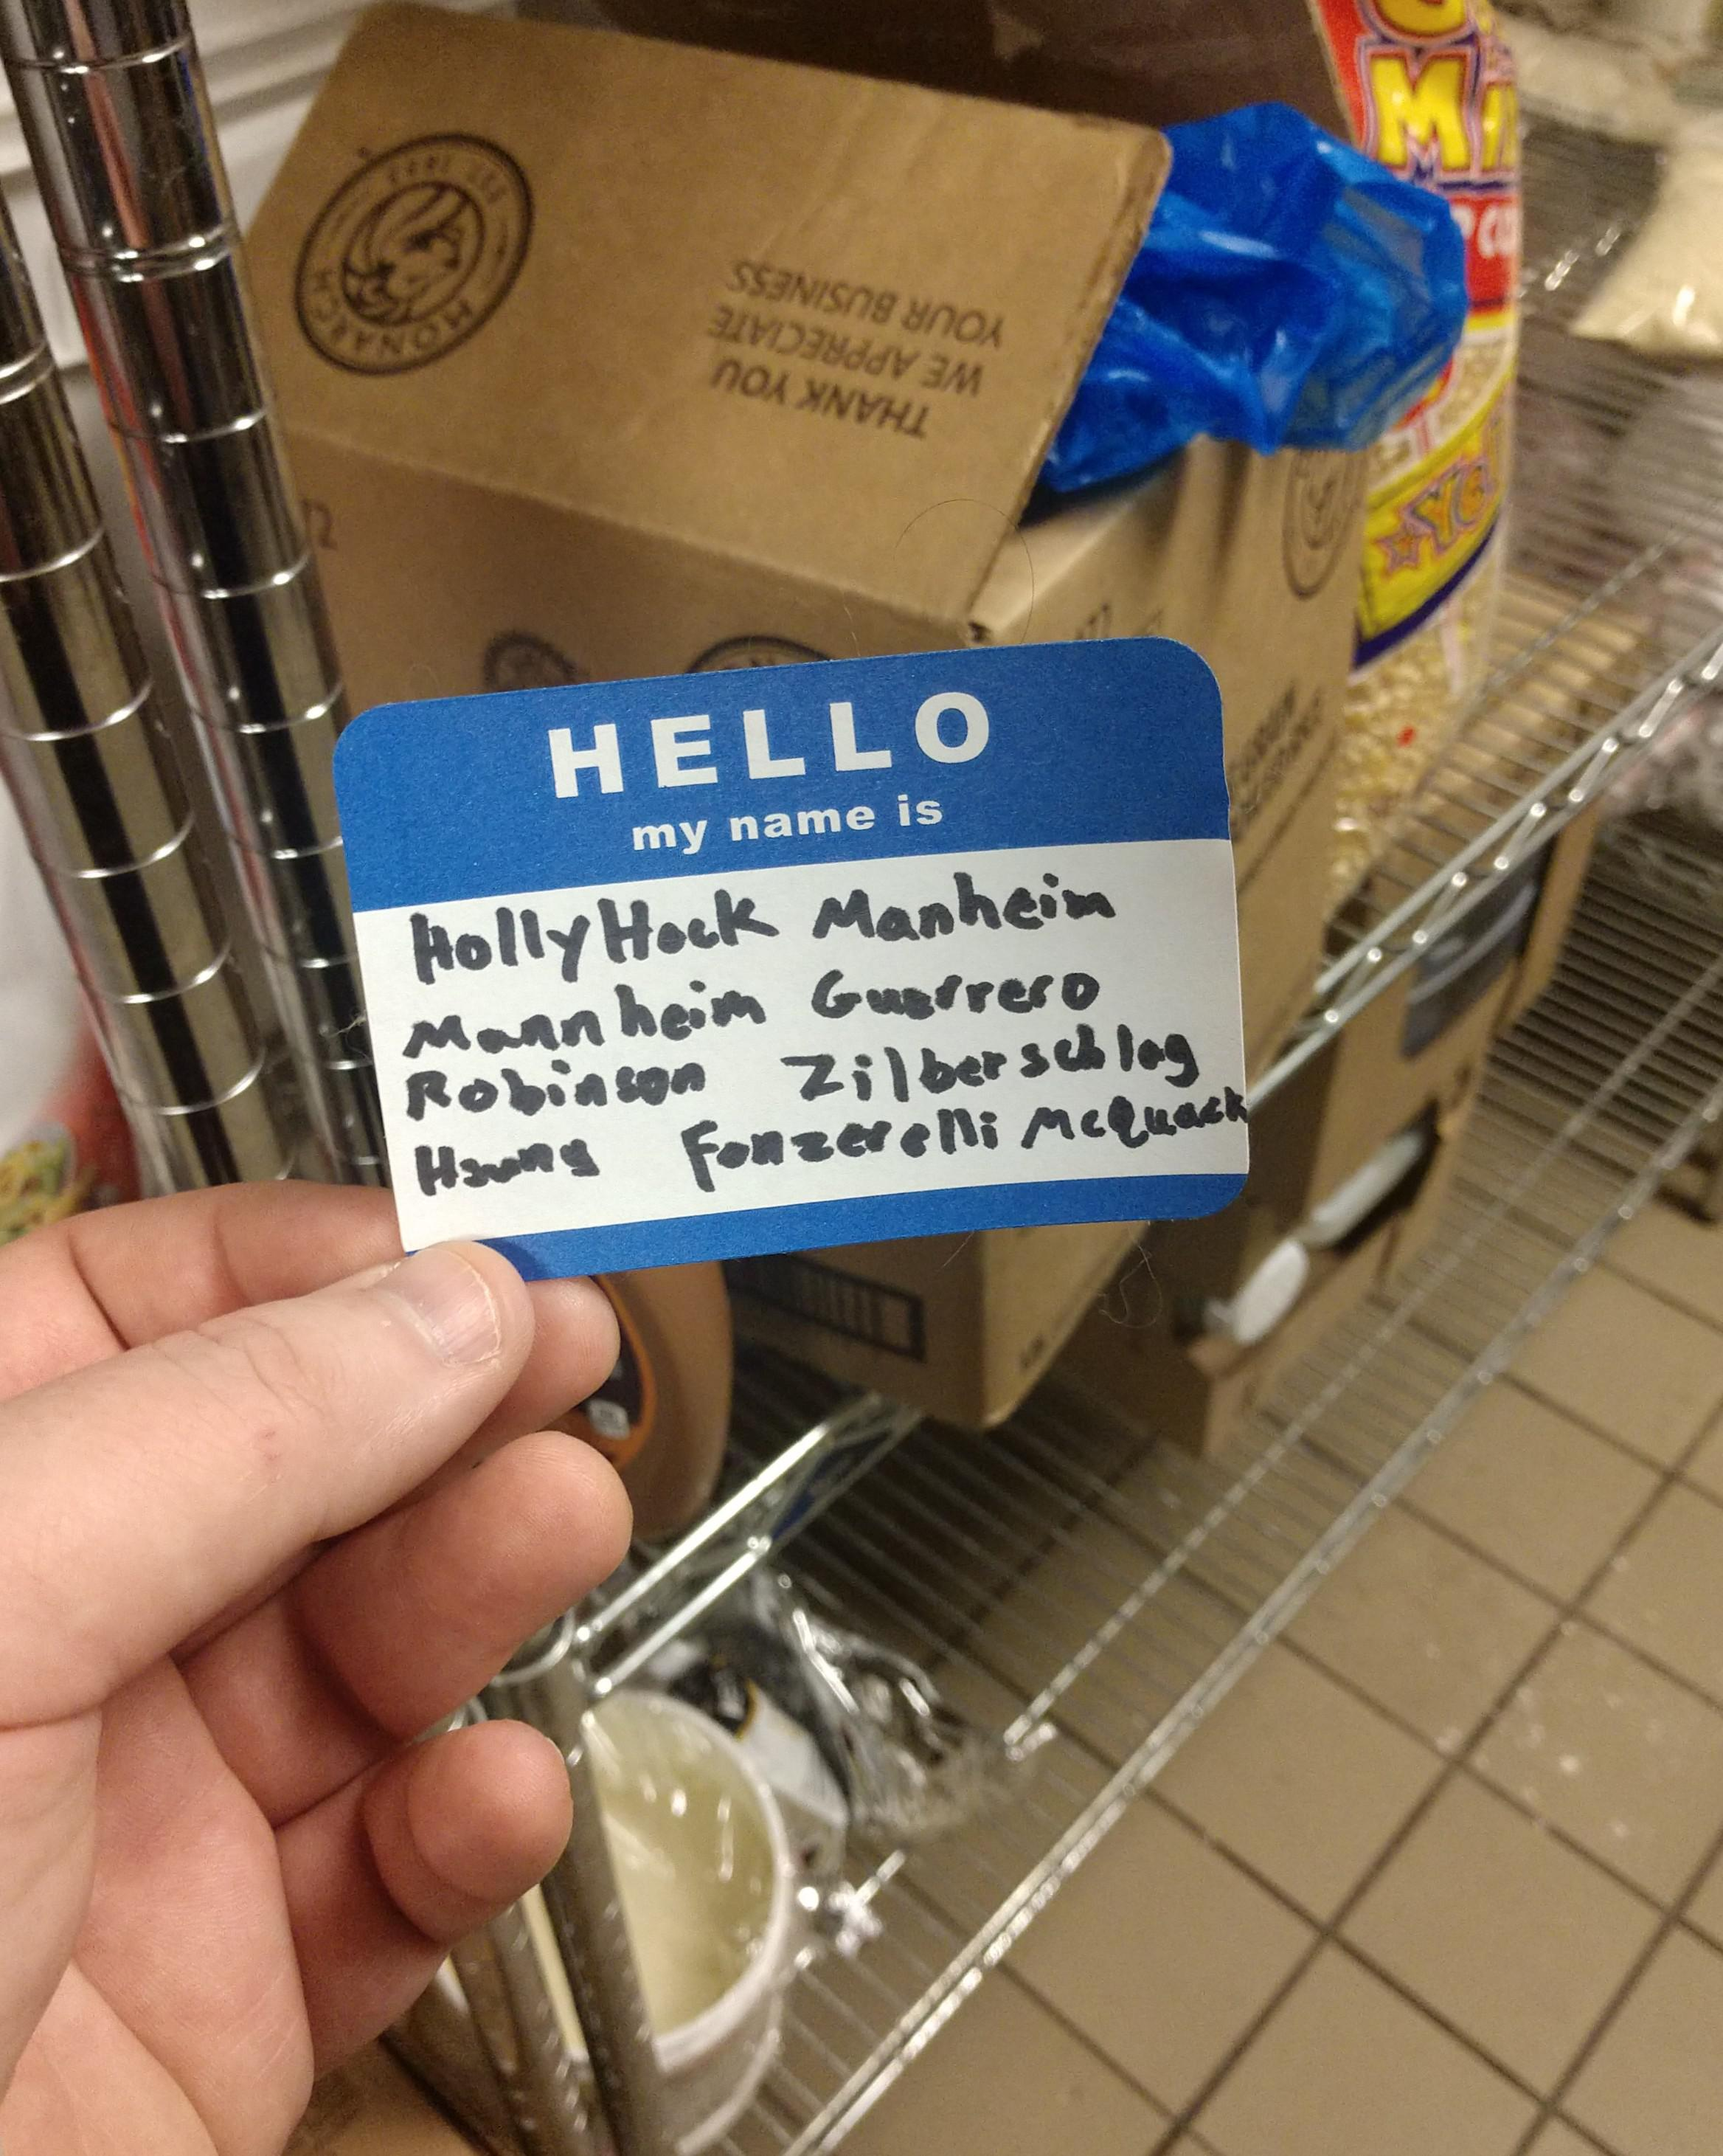
(put your name here) (n)indizhinikaaz.
Kaaz
Nikaaz
Zhinikaaz
Dizhinikaaz
(n)indizhinikaaz
(name) (n)indizhinikaaz.

Slide 4
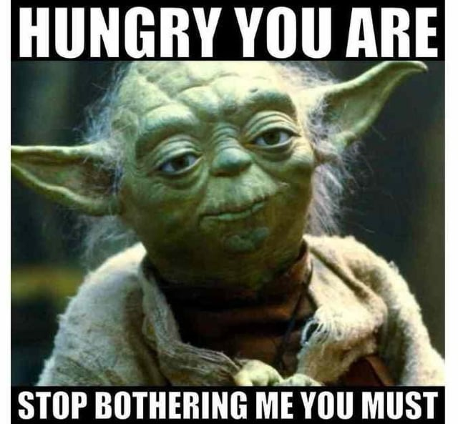
Izhinikaazo 's/he is called a certain way; has a certain name'
The first /n/ is optional.
(name) (n)indizhinikaaz.
(name) gidizhinikaaz.
Yoda izhinikaazo.

Slide 5


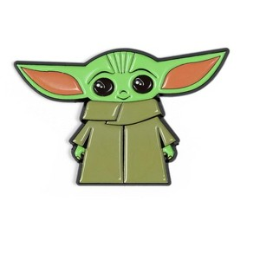
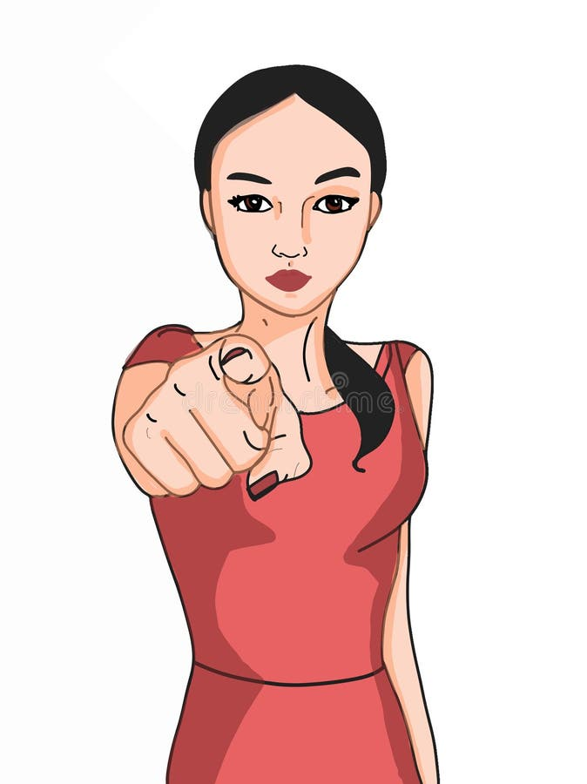
Aaniin! Aaniin? :)
Aaniin ezhinikaazoyan? _______________ (n)indizhinikaaz.
Aaniin ezhinikaazoyaan? _______________ gidizhinikaaz.
Aaniin ezhinikaazod? YODA izhinikaazo.
Niin
Giin
Wiin

Slide 6
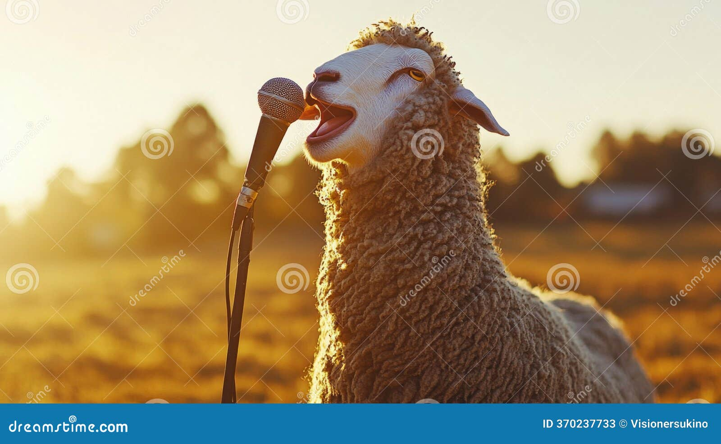
Nagamodaa Bapasininjii'odizoyang!
Aaniin ezhinikaazoyan?
  Repeat: Aaniin ezhinikaazoyan?
_________ indizhinikaaz.
  Repeat: _________ gidizhinikaaz.

Slide 7
Niwiinzowinan 'My names'
_____________ nizhaaganaashiiwinikaaz.
_____________ gizhaaganaashiiwinikaaz.
_____________ zhaaganaashiiwinikaazo.
_____________ (n)indanishinaabewinikaaz.
_____________ gidanishinaabewinikaaz.
_____________ anishinaabewinikaazo.
Zhaaganaashiiwinikaazo 's/he is called by a certain English name'
Anishinaabewinikaazo 's/he is called by an Ojibwe name'
Gaawiin mashi (n)indanishinaabewinikaazosiin. 'I do not have an Anishinaabe name yet.'

Slide 8
Goal for today...
Be able to say:
  My name is ______.
    ________ (n)indizhinikaaz.
  Your name is _____.
    _______ gidizhinikaaz.
  H/ name is _____.
    _______ izhinikaazo.
To work on for Thursday:
My name is ________. My English name is _______.
Your name is ______. Your English name is ______.
H/ name is _______. H/ English name is ______.

