Slide 1

Maajii-ojibwemodaa I
Dagwaagig 2026
Gide'inaan

Slide 2
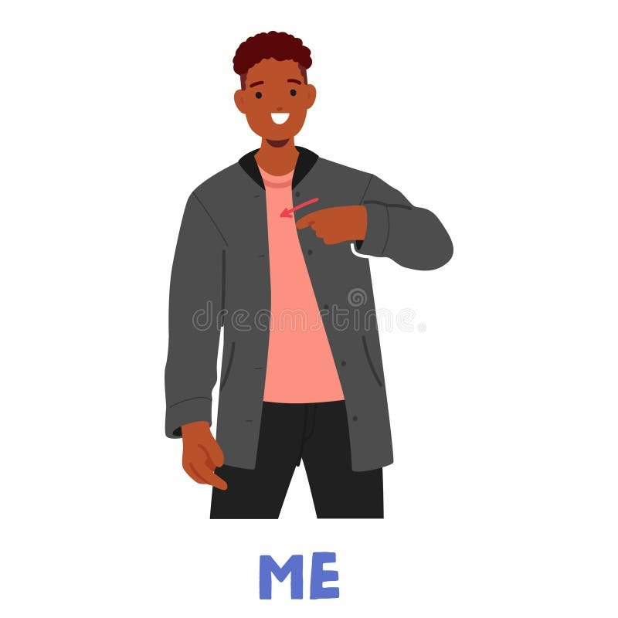
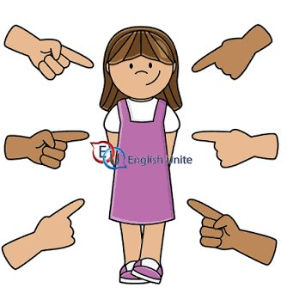
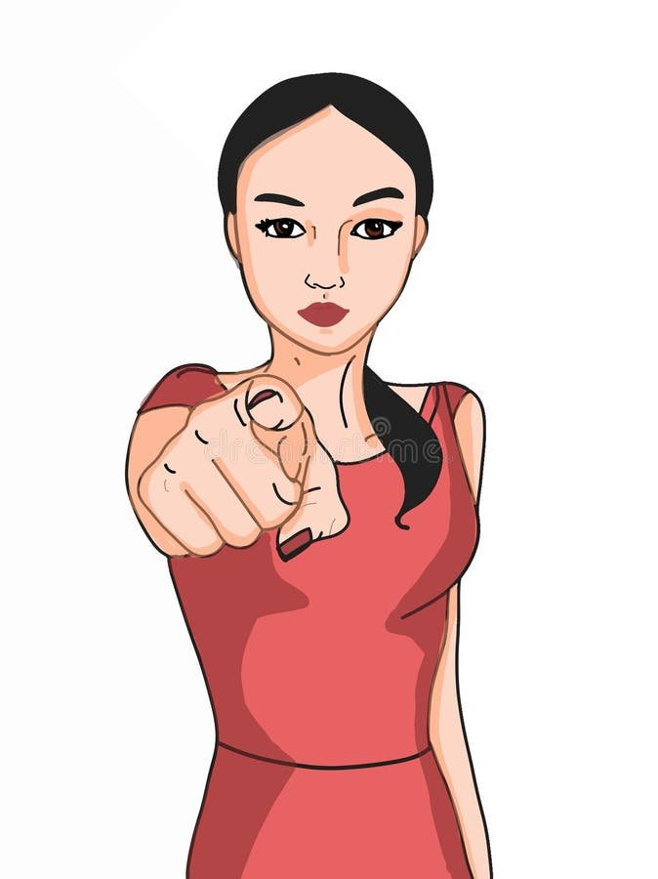
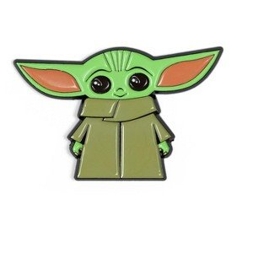
Gagwejindidaa 'Let's ask each other'
Aaniin ezhinikaazoyan?
  My name is ______.
    ________ (n)indizhinikaaz.
  Your name is _____.
    _______ gidizhinikaaz.
  H/ name is _____.
    _______ izhinikaazo.
Aaniindi wenjibaayan?
  I am from ______.
    ________ (n)indoonjibaa.
  You are from _____.
    _______ gidoonjibaa.
  H/ is from _____.
    _______ onjibaa.

Slide 3
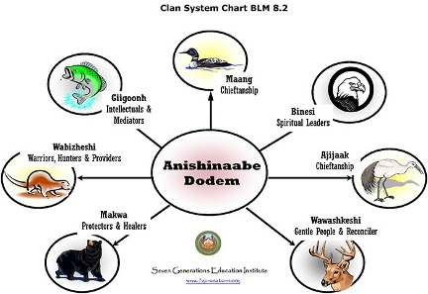
Awenen gidoodem? 'Who is your clan?'
•_________________ (n)indoodem. ‘________ is my clan.’
•We take our father’s clan.
•Makwa ‘bear’
•Migizi ‘eagle’
•Ajijaak ‘crane’
•Bizhiw ‘lynx’
•Awaazisii ‘bullhead’
•Waabizheshi ‘pine marten’
•Maang ‘loon’
Ma'iingan 'wolf'
•Name ‘sturgeon’
Mikinaak ‘turtle’
Gaawiin mashi ningikenimaasiin nindoodem.
‘I don’t know who my clan is yet.’
Includes subclans
•Awaazisii ‘Bullhead’
•Name ‘Sturgeon’
•Maanameg ‘catfish’
Includes subclans
•Migizi
•Giniw
Gekek

Slide 4
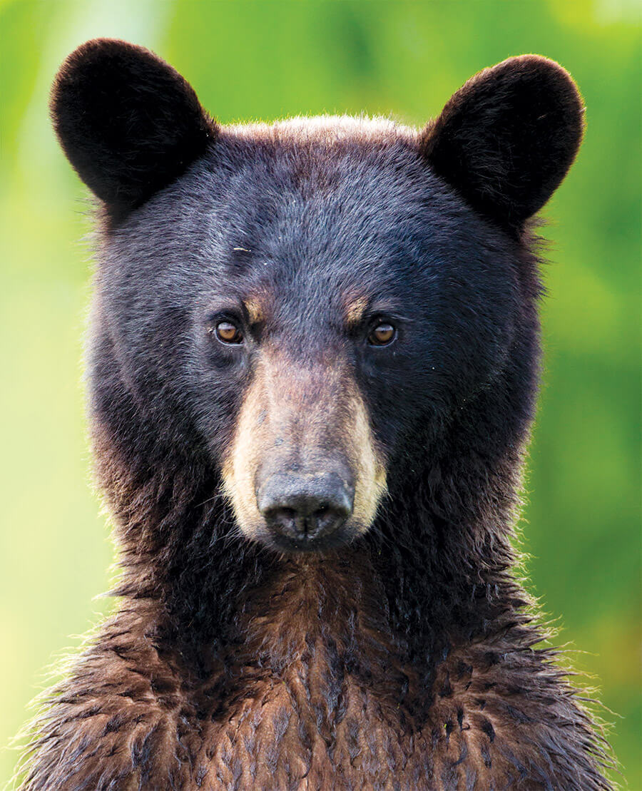
Makwa (n)indoodem 'My clan is bear; I am bear clan'
The founding clan of LCO.
Traditionally the largest clan at LCO.
Social responsibilities with medicines/healing and community security.
Tend to be spiritually gifted with medicines, plants, recipies.
Tend to be good hunters, good warriors.
Known stereotypically by their thick hair.

Slide 5
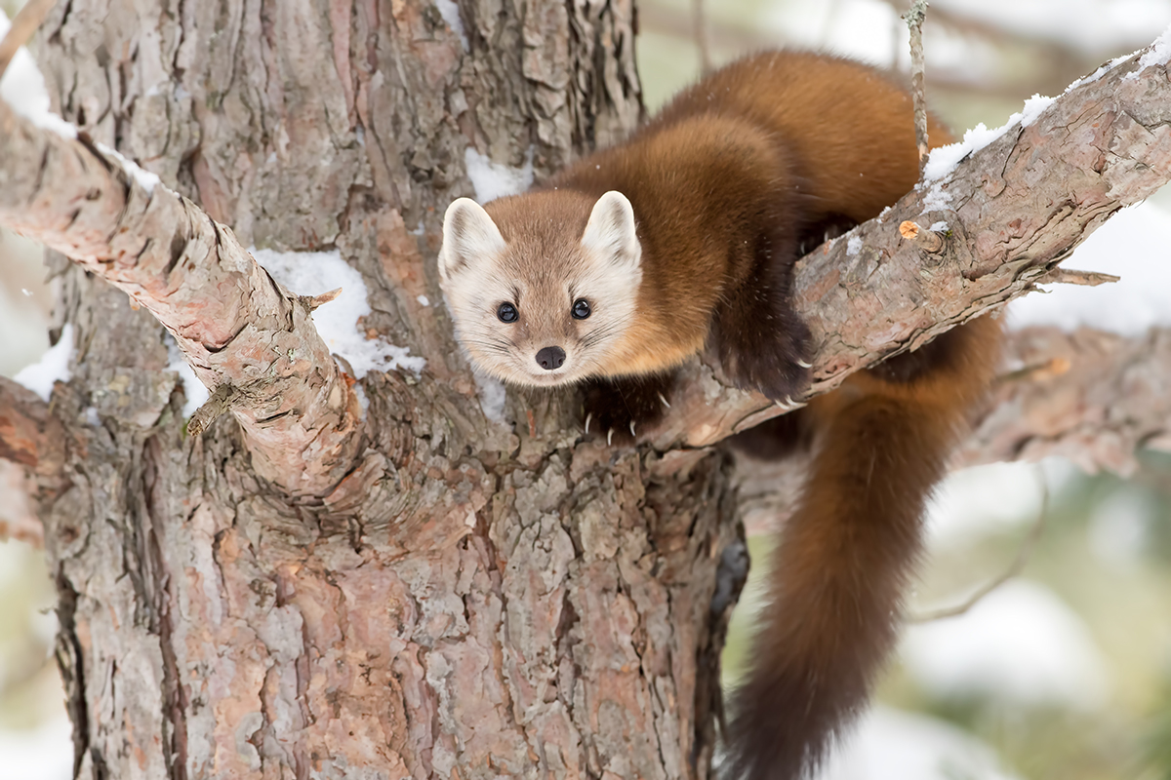
Waabizheshi (n)indoodem 'My clan is marten; I am marten clan'
Prominent warrior clan.
For some communities/teachings, an adopting clan for children with Native fathers without clans.
Social responsibilities with being providers.
Tend to be good hunters, good warriors.
Known stereotypically by their fearlessness.

Slide 6
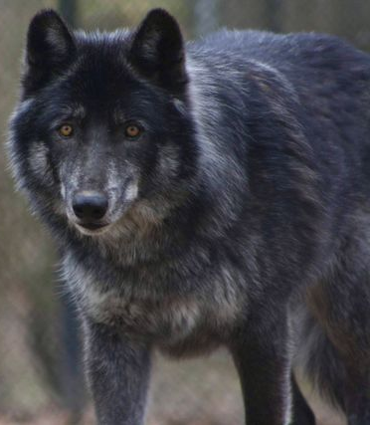
Ma'iingan (n)indoodem 'My clan is wolf; I am wolf clan'
The adopting clan of the mixed bloods.
Children of Native fathers from other tribes (Dakota) adopted into the Ma'iingan doodem (regional).
Social responsibilities as hunters and warriors.
Tend to be wise in their old age.
Stereotpically known for being protective and defensive.

Slide 7
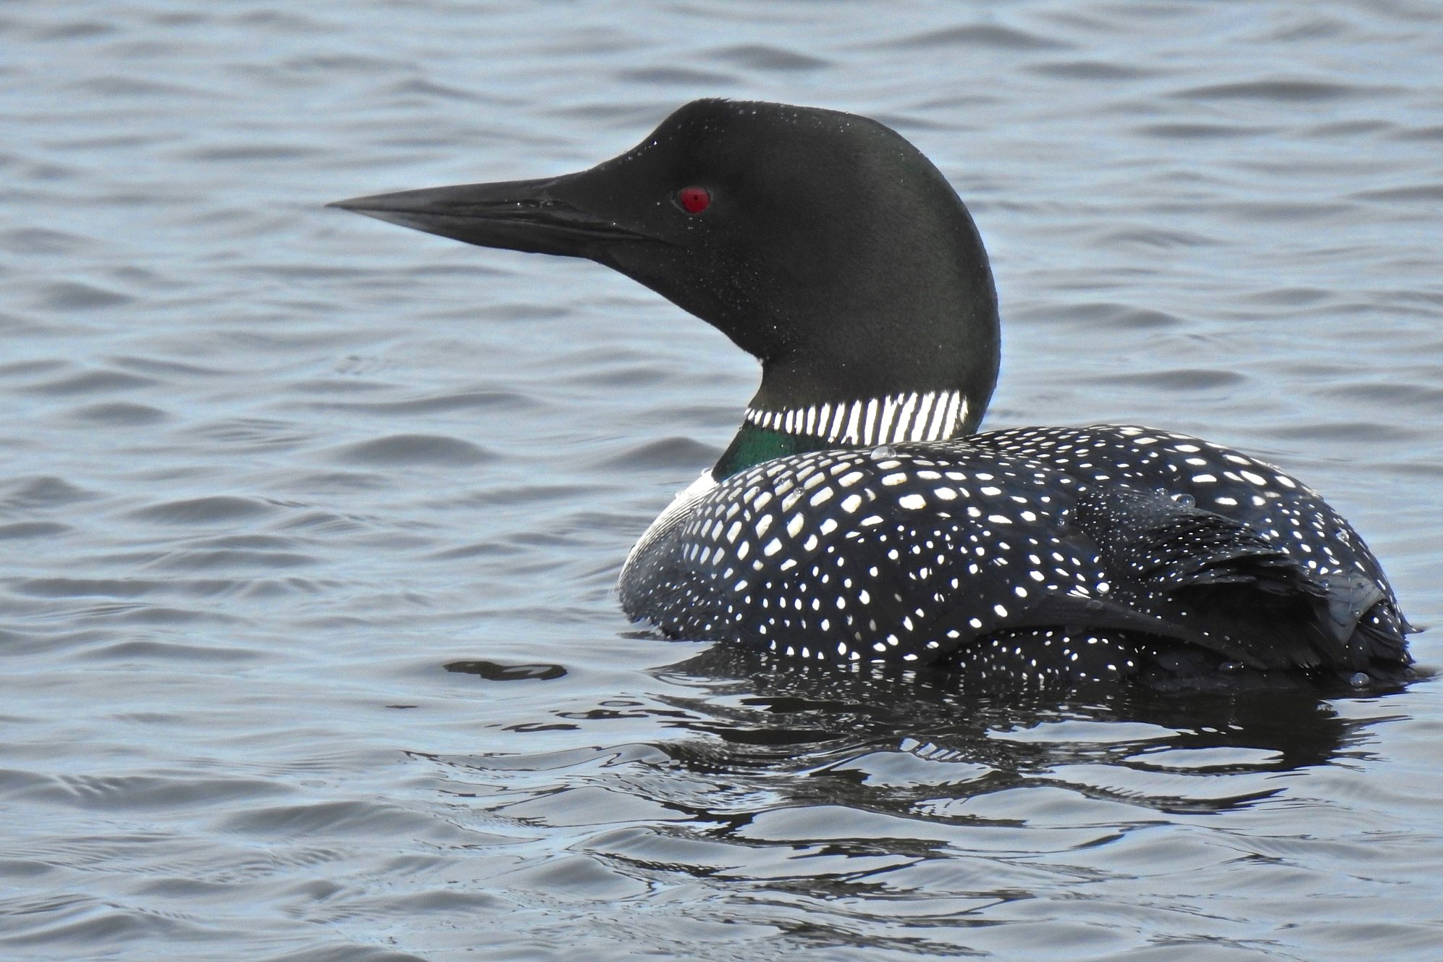
Maang (n)indoodem 'My clan is loon; I am loon clan'
Leadership clan, internal band diplomacy.
Responsible for community leadership, conflict resolution, mediation.
Hereditary chiefs lineage.
Known for their gift of public speaking.
Stereotypically known to be great speakers and singers.

Slide 8
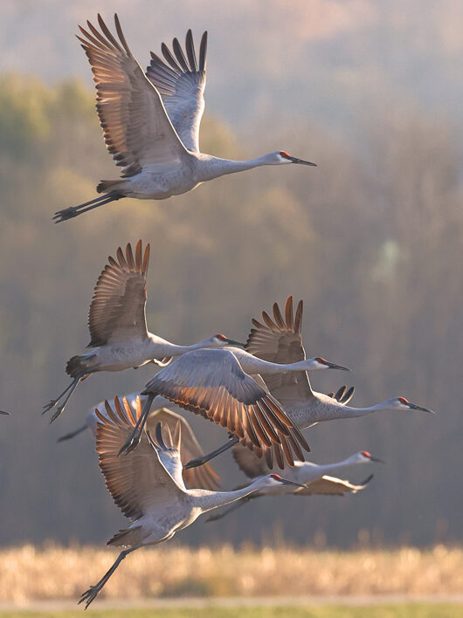
Ajijaak (n)indoodem 'My clan is crane; I am crane clan'
The original leadership clan, inter-tribal diplomacy.
Responsible for advocacy, leadership of the leaders.
Hereditary chiefs lineage.
Known for their gift of public speaking.
Stereotypically known to be great speakers and singers.

Slide 9
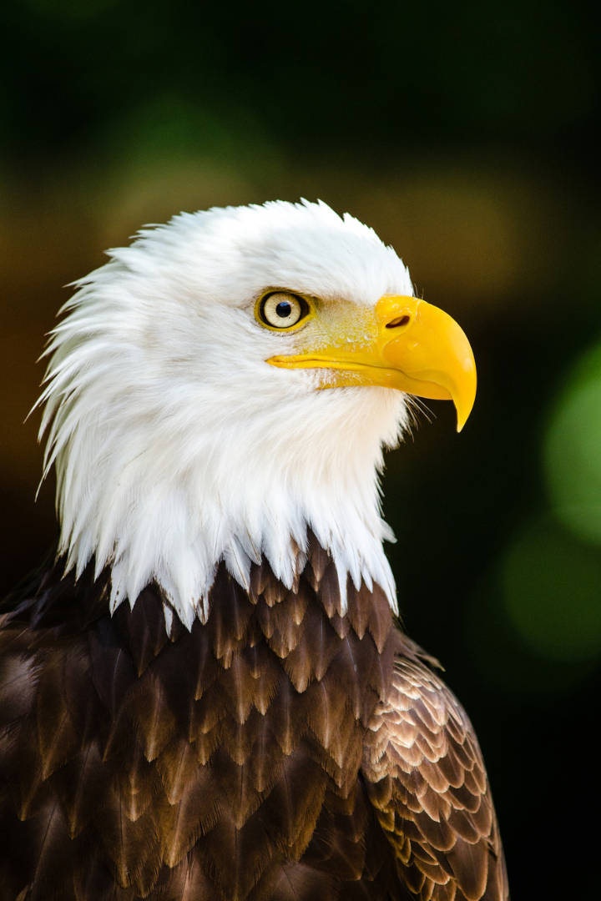
Migizi (n)indoodem 'My clan is eagle; I am eagle clan'
The adopting clan of the mixed bloods.
Children of white fathers adopted into the Migizi doodem (regional).
Social responsibilities with ceremonial leadership.
Tend to be gifted with stories and songs.
Stereotpically known for white thin hair in old age.

Slide 10
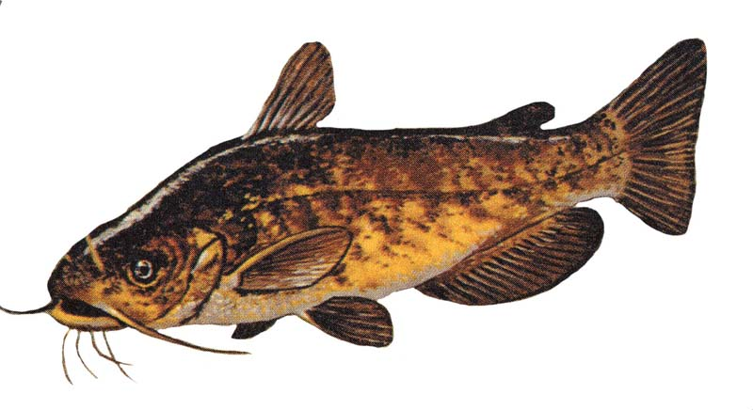
Awaazisii (n)indoodem 'My clan is bullhead; I am bullhead clan'
The original educators.
Philosophers and intellectuals.
Social responsibilities with ceremonial leadership, tribal history, and sacred legends.
Tend to be gifted with interpersonal skills.
Stereotpically known for balding or thin hair in old age.

Slide 11
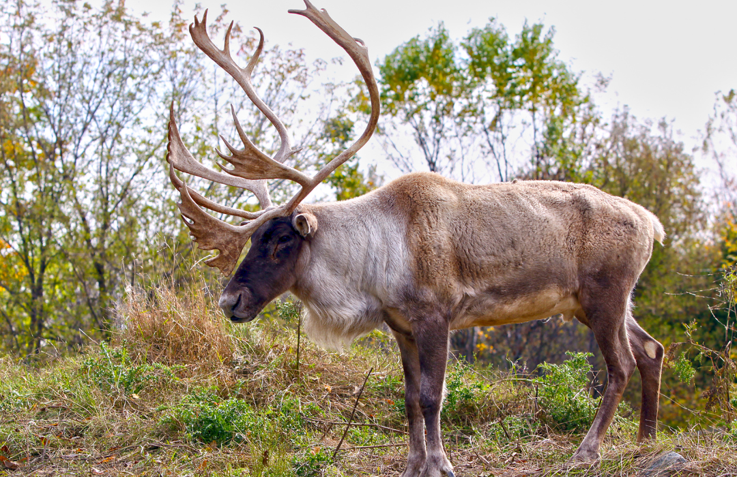
Adik (n)indoodem 'My clan is caribou; I am caribou clan'
The original 'deer clan'.
Compassionate thinkers, mediators, counselors.
Social responsibilities with conflict resolution and keeping peace.
Exiled from the region due to intermarriage.
Stereotpically known for gentle, kind nature.

Slide 12
(n)indoodem, gidoodem, odoodeman
Migizi indoodem 'My am eagle clan.'
Migizi gidoodem 'You are eagle clan.'
Migiziwan odoodeman a'aw Ogimaa-ayaabe. 'Ogimaa-ayaabe is eagle clan.'
Whenever we talk about wiin's clan (h/ clan), we put an extra ending on the animal and the word for clan (shown in red):
Migiziwan makwan ma'iinganan ajijaakwan maangwan adikwan awaazisiin waabizheshiwan bizhiwan, etc.
Awazisiin odoodeman Yoda.
'Yoda is bull-head clan'

Slide 13
Gagwejindidaa 'Let's ask each other'
Aaniin ezhinikaazoyan?
  My name is ______.
    ________ (n)indizhinikaaz.
  Your name is _____.
    _______ gidizhinikaaz.
  H/ name is _____.
    _______ izhinikaazo.
Aaniindi wenjibaayan?
  I am from ______.
    ________ (n)indoonjibaa.
  You are from _____.
    _______ gidoonjibaa.
  H/ is from _____.
    _______ onjibaa.
Awenen gidoodem?
  I am ______ clan.
    ________ (n)indoodem.
  You are _____ clan.
    _______ gidoodem.
  H/ is _____ clan.
    _______(an) odoodeman.

