Slide 1

Maajii-ojibwemodaa I
Dagwaagig 2026
Gide'inaan

Slide 2
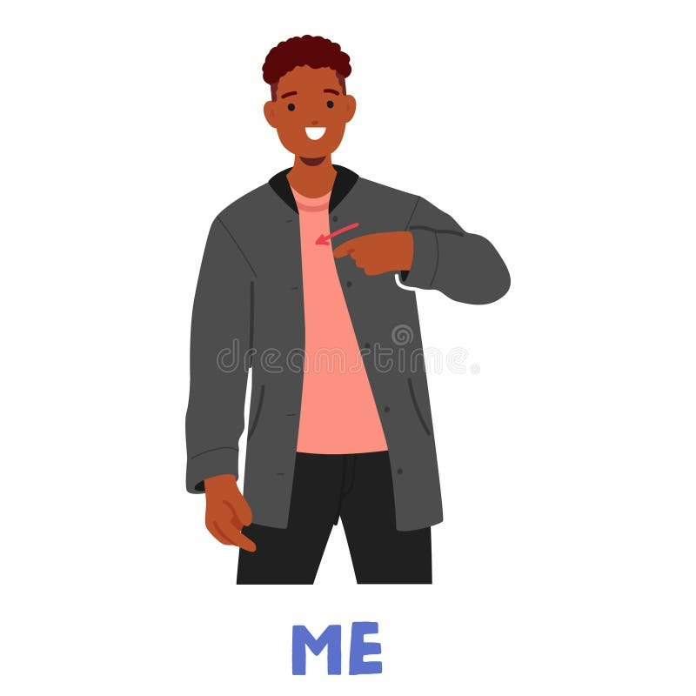
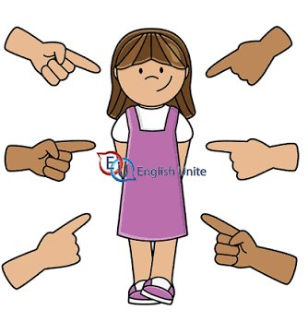
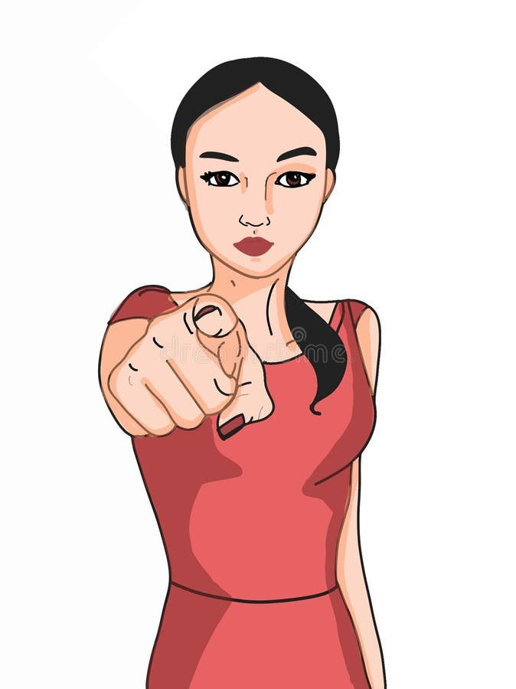
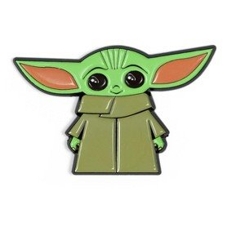
Gagwejindidaa 'Let's ask each other'
Aaniin ezhinikaazoyan?
  My name is ______.
    ________ (n)indizhinikaaz.
  Your name is _____.
    _______ gidizhinikaaz.
  H/ name is _____.
    _______ izhinikaazo.
Aaniindi wenjibaayan?
  I am from ______.
    ________ (n)indoonjibaa.
  You are from _____.
    _______ gidoonjibaa.
  H/ is from _____.
    _______ onjibaa.
Awenen gidoodem?
  I am ______ clan.
    ________ (n)indoodem.
  You are _____ clan.
    _______ gidoodem.
  H/ is _____ clan.
    _______(an) odoodeman.
Giizhigong 'up in the sky'
Niin
Giin
Wiin

Slide 3
(n)indoodem, gidoodem, odoodeman
Awenen gidoodem?
Migizi indoodem 'My am eagle clan.'
Migizi gidoodem 'You are eagle clan.'
Migiziwan odoodeman a'aw Ogimaa-ayaabe. 'Ogimaa-ayaabe is eagle clan.'
Whenever we talk about wiin's clan (h/ clan), we put an extra ending on the animal and the word for clan (shown in red):
Migiziwan makwan ma'iinganan ajijaakwan maangwan adikwan awaazisiin waabizheshiwan bizhiwan, etc.
Awazisiin odoodeman Yoda.
'Yoda is bull-head clan'

Slide 4
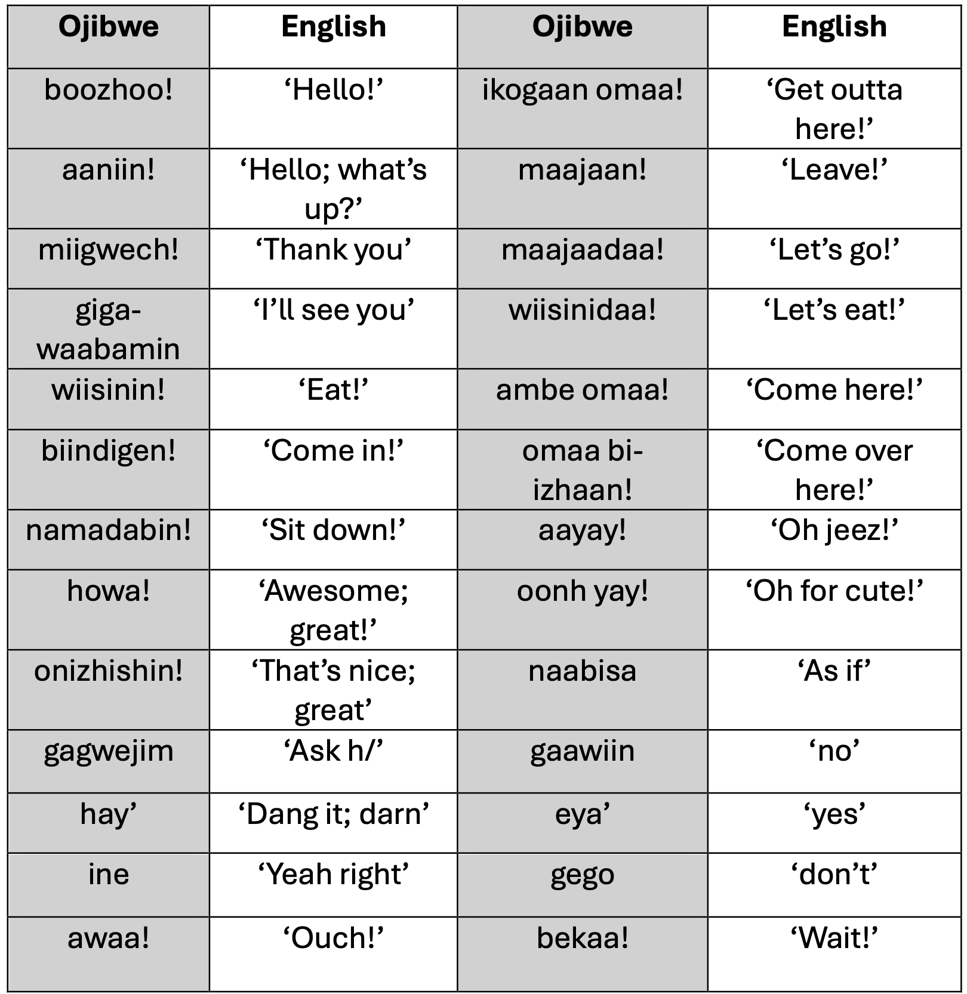
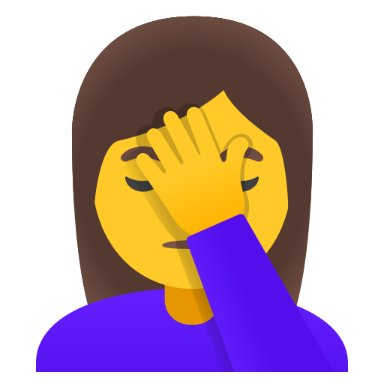
Common and frequent expressions
Tagiizh naa!
'Oh yeah, that's right! (now I remember!)'

Slide 5
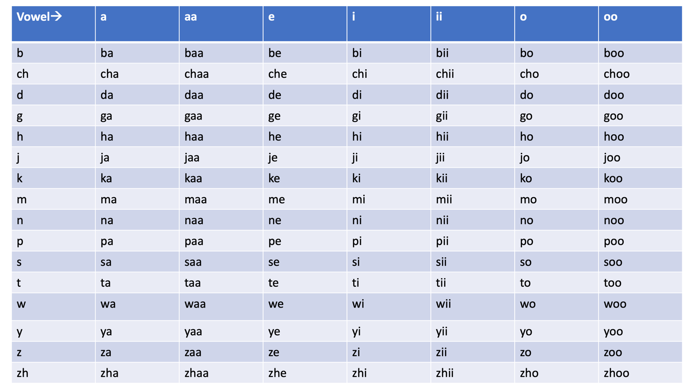

Slide 6
Ikidon! 'Say it!' (telling one person)
Nibi 'water'
Asab 'a net'
Animosh 'dog'
Naasaab 'the same'
Bakaan 'different'
Ishpiming 'up above'
Omaa 'here'
Waawanoon 'eggs'
Akiwenzii 'old man'
Mindimooyenh 'old lady
Ingoji 'somewhere'
Gaawesa! 'Now way!'
Gaagoons 'little porcupine'
Gwiiwizens 'little boy'
Ikwezens 'little girl'
Biibiiyens 'baby'
iibii'ige 's/he emails'
Zoomidoonetaa 's/he is in a Zoom mtg.'
Ojibwemowin 'the Ojibwe language'
Ishkoniganing 'on the rez'
Aakoziiwigamigoonsing 'at the clinic'
Endaayaan 'at (my) home'
Wanaanimizi 's/he panics'

Slide 7
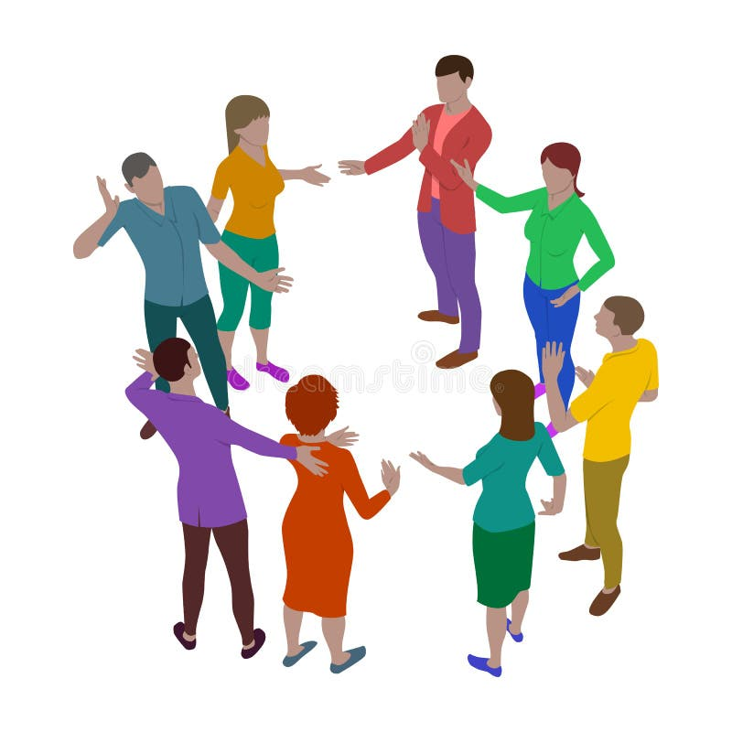
Ozhibii'amok!
Bazigwiidaa! Ashi-bezhig odaminodaa!
Medicine
mashkiki
Food
wiisiniwin
Chair
apabiwin
Makes people dance
Niimi'iwe
Feed h/!
asham
Help h/!
wiidookaw
Ducks
zhiishiibag
S/he is shown something spiritual
Waabanda'igoowizi

Slide 8
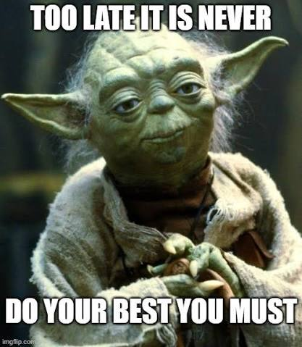
Mii wa'aw nimbadi'iim. 'This is my buddy.'
________________ izhinikaazo.
________________ onjibaa.
________________ odoodeman.

Slide 9
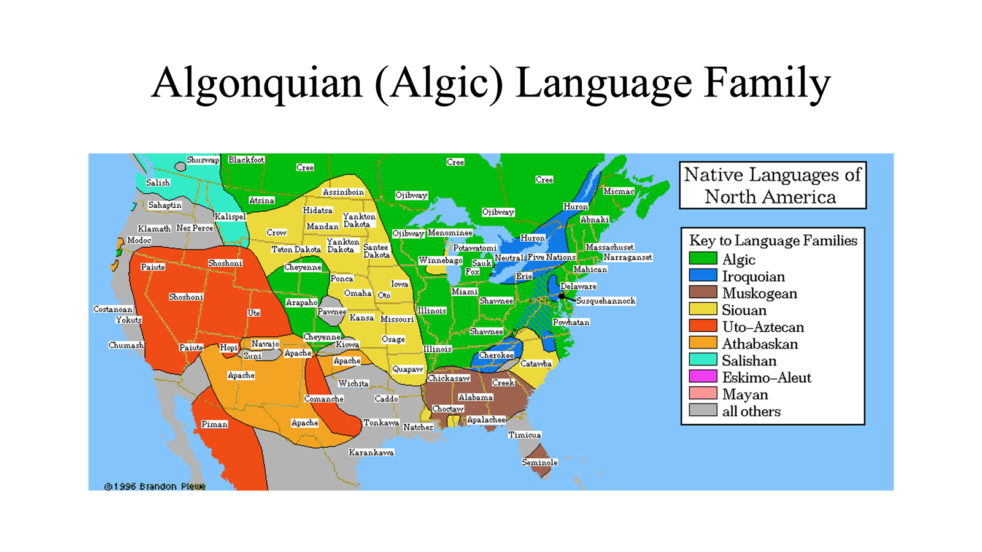

Slide 10
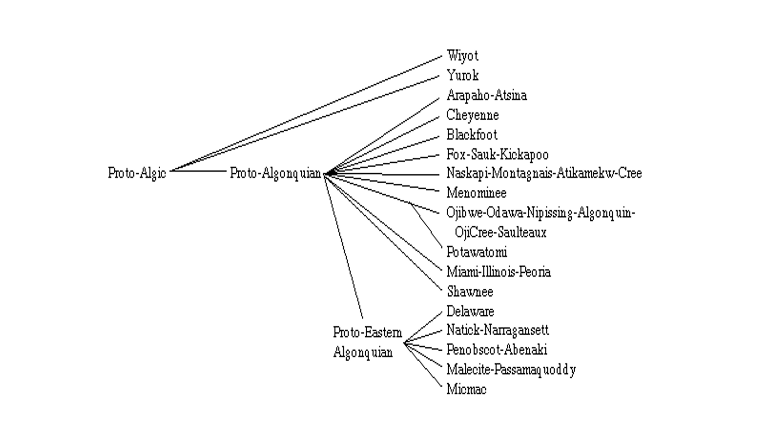

Slide 11
