Slide 1

Naawakweg Wiidoopanding
Intermediate Lunch
Dagwaagig 2026

Slide 2
Aaniindi wenji-zoomidoonetaayan?
Endaayaan 'my home'
Ozhibii'igewigamig(ong) 'the office'
Odaabaan(ing) 'the car'
(Place) (n)indoonji-zoomidoonetaa.
  Zoomidoonetaa vai 's/he engages in a Zoom meeting'
Gide'inaan Misko-waakaa'iganing omaa Odaawaa-zaaga'iganing indoonji-zoomidoonetaa.

Slide 3
Awegonen maajiyan?
Giishpin ayi'iiwang: _____________ nimiijin(an)
Giishpin aya'aawid: _____________ (n)indamwaa(g).
Naboob 'soup
Ashkibagwanjigan 'salad'
Opinii-gaapanjigan(an) 'chips'
Ziinzibaakwadoons(an) 'candy'
Gitigaanens(as) 'veggies'
Nabonigan 'sandwich'
Wiisagadesijigan 'pizza'
Zaasakokwaan 'frybread'
Wemitigoozhii-opiniins(ag) 'french fries'
Bagaan(ag) 'peanut(s)'
Gaawiin gegoo nimiijisiin. :(
(n)ingidimaagiz gosha.

Slide 4
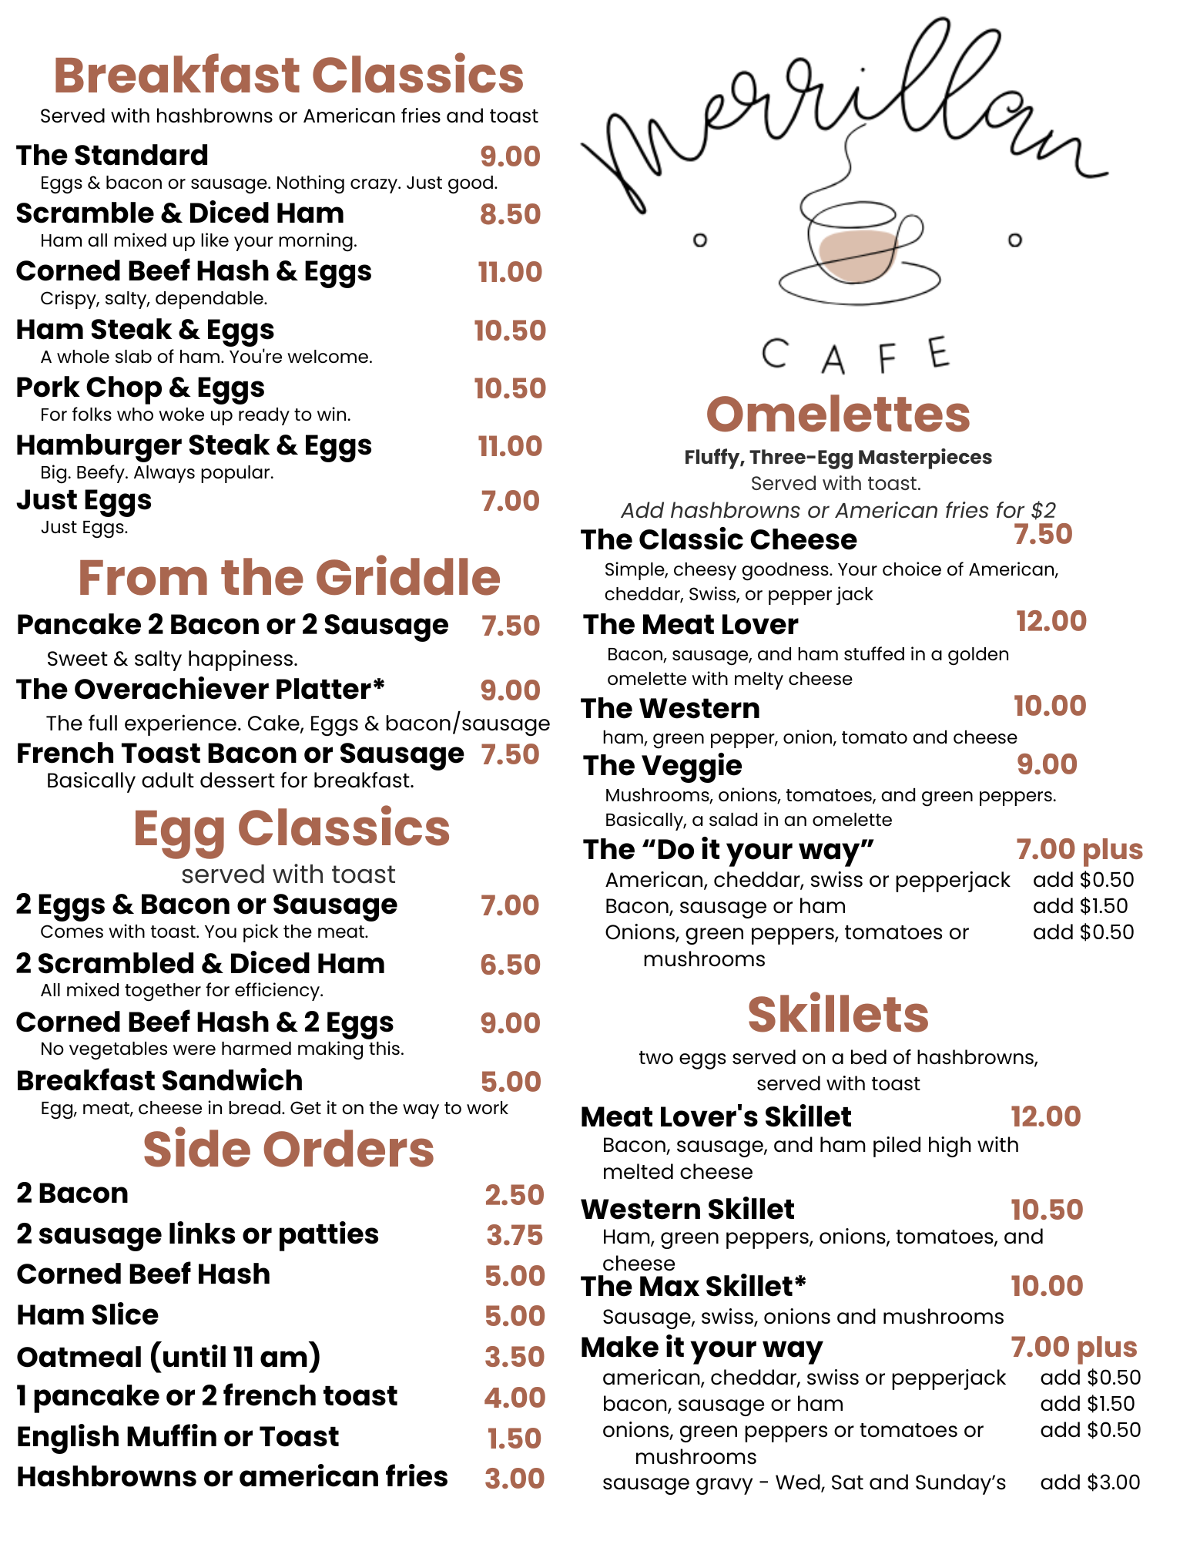
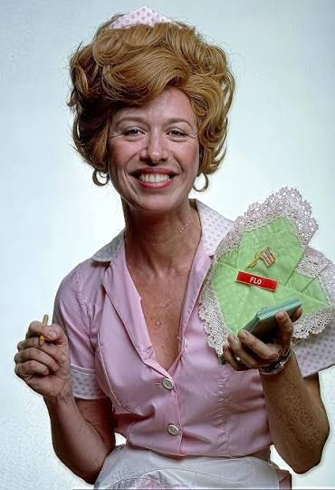
"Awegonen waa-ayaaman?"

Slide 5
"Awegonen waa-ayaaman?"
Awegonen waa-minikweyan?
Awegonen waa-miijiyan?
Aaniin ezhi-minwendaman waawanoon?
Eggs waawanoon gaa-kabaachigaadegin, those that are boiled, ozhaashi-manoomin oatmeal and Naa go gaye bacon grease gookooshi-bimide .
Aaniin ezhinikaadeg 'sausage'?
Aaniin ekidoyan 'bacon'?
Aaniin ge-ikidoyamban 'fried'?

Slide 6
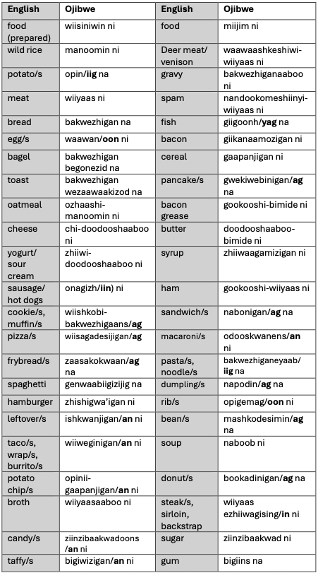
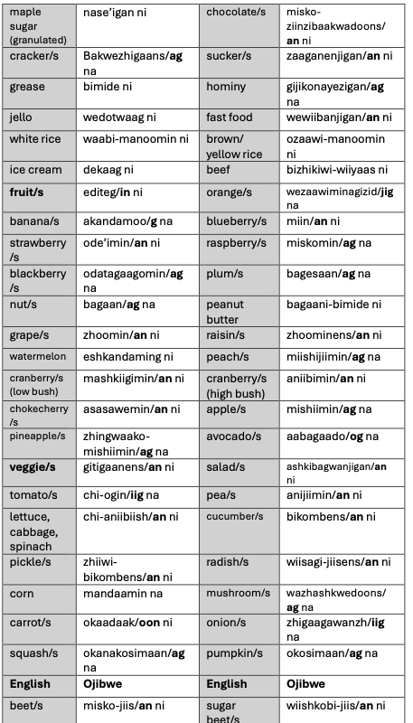
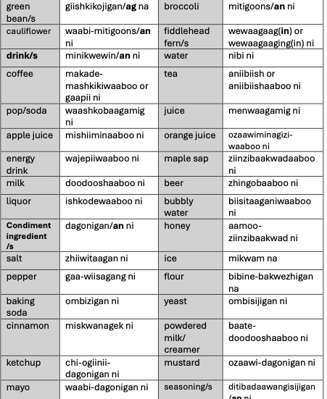
From the new Gide'inaan "Maajii-ojibwemodaa" language book.

Slide 7

Gegoo na giwii-kagwejimim?
Homework for next time:
  Until the website is set up, email us for the slides. Ojibwemowin@lco-nsn.gov
  As you cook, as you eat, keep track of what you know how to say and what you don't know how to say.
  Bring your questions for next time.

