Slide 1

Naawakweg Wiidoopanding
Intermediate Lunch
Dagwaagig 2026

Slide 2
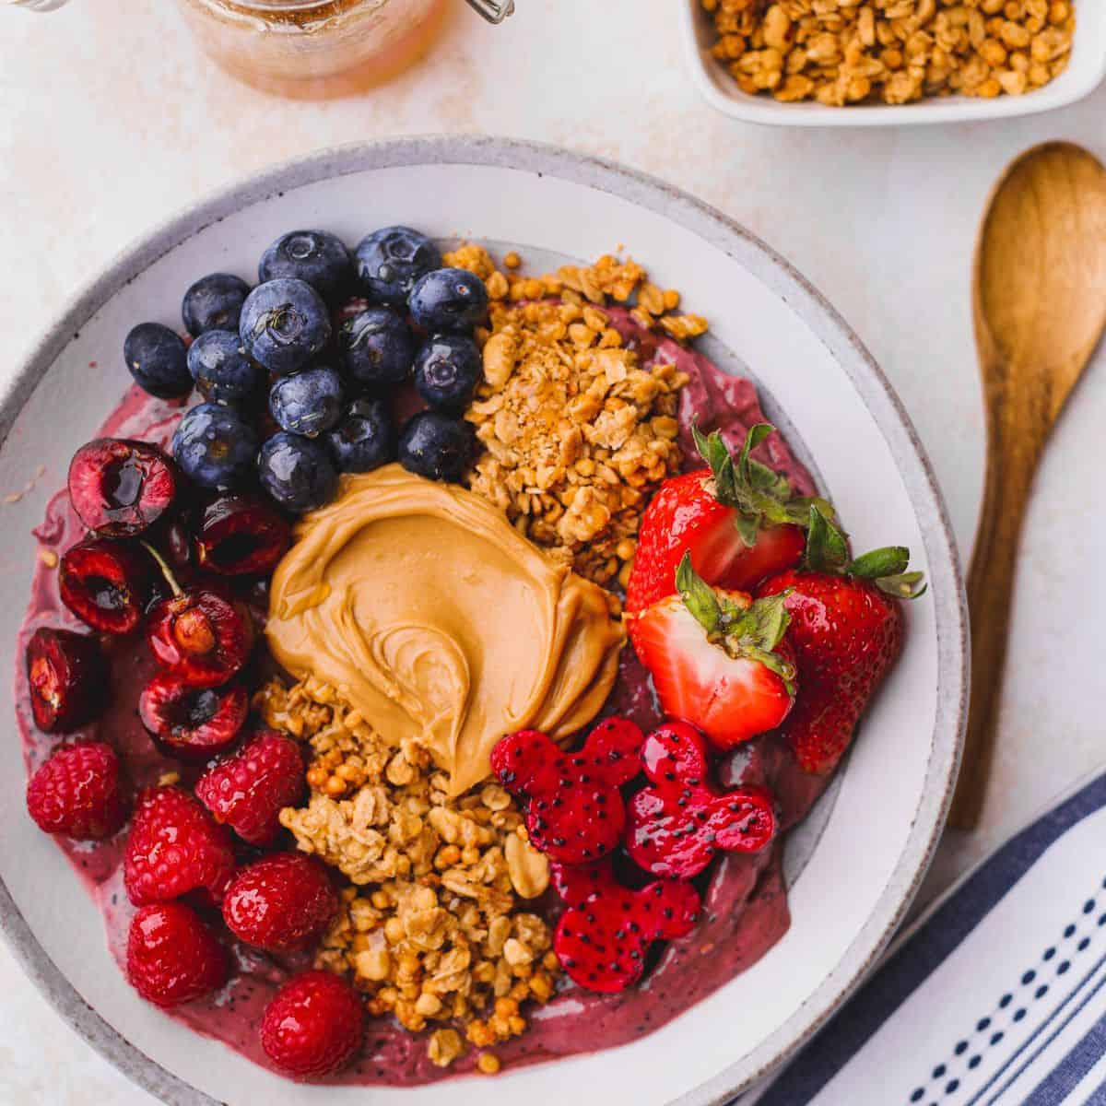
Awegonen maajiyan?
Giishpin ayi'iiwang: _____________ nimiijin(an)
Giishpin aya'aawid: _____________ (n)indamwaa(g).
Naboob 'soup'
Ashkibagwanjigan 'salad'
Opinii-gaapanjigan(an) 'chips'
Ziinzibaakwadoons(an) 'candy'
Gitigaanens(an) 'veggies'
Nabonigan 'sandwich'
Wiisagadesijigan 'pizza'
Zaasakokwaan 'frybread'
Wemitigoozhii-opiniins(ag) 'french fries'
Bagaan(ag) 'peanut(s)'
Gaawiin gegoo nimiijisiin. :(
(n)ingidimaagiz gosha.

Slide 3

Nawaj ginwaabiigisidoodaa...
Waawanoon ingii-miijinan.
  Aaniin apii?
Waawanoon ingii-miijinan zhebaa.
  Aaniindi?
Waawanoon ingii-miijinan zhebaa iwidi endaayaan.
  Awegonen dinowa?
Waawanoon gaa-saasakokwaadegin ingii-miijinan zhebaa iwidi endaayan.
  Nawaj wii-jiikitaagoziyan...
Nashke! Zhebaa iwidi endaayaan gii-kikizhebaa-wiisiniyaan, waawanoon gaa-saasakokwaadegin ingii-miijinan.

Slide 4
Awegonen gaa-miijiyan bijiinaago?
Aaniin wapii? | Awegonen?
Gigizheb | Oshki-ojibwemod... | Nawaj ani-nitaawed...
 | Waawanoon ingii-miijinan, onagizhiinsan, opiniig igo gaye. | Wa! Weweni ingii-kiizizamaag gigizhebaa-wiisiniwin a'aw niwiiw. Waawanoon ingii-saasakokwaadamaag weweni wii-apanjigeyaan. Ogii-ozaawaakizwaan aniw bakwezhiganan....
Naawakweg | Oshki-ojibwemod... | Nawaj ani-nitaawed...
 | Onagizhiins ingii-miijin.
Onaagoshig | Oshki-ojibwemod... | Nawaj ani-nitaawed...

Slide 5
Aaniin gaa-izhichigeyan gii-anwebi'igooyang?
Aaniin wapii? | Aaniin?
Bijiinaago | Oshki-ojibwemod... | Nawaj ani-nitaawed...
 | Gaawiin gegoo ingii-izhichigesiin bijiinaago. | Anooj igo ingii-izhichige bijiinaago. Gaawiin dash ingoji ingii-izhaasiin. Gaa-goshkoziyaan, ingii-maminikwen makade-mashkikiwaaboo megwaa zhazhingishinaan dapaabiyaan waasechiganing gabe-gigizheb. Mii dash gii-onishkaayaan wii-kiziibiiga'igeyaan...
Awasanaago | Oshki-ojibwemod... | Nawaj ani-nitaawed...
Gii-naano-giizhigak | Oshki-ojibwemod... | Nawaj ani-nitaawed...

Slide 6

Giiwewijigan 'Homework'
Get a small notebook for language/words or start a note file on your phone.
As you move through the day, pay attention to your everyday activities that you do not yet know how to say.
Look those words up and add them to your notebook/note file.
For the words you cannot find, bring your questions for Monday.

