Slide 1

Naawakweg Wiidoopanding
Intermediate Lunch
Dagwaagig 2026

Slide 2
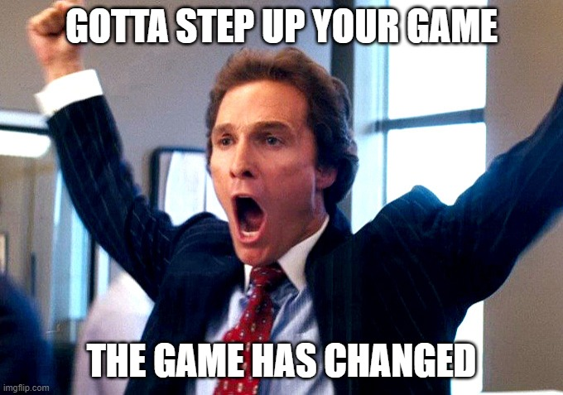
Aaniin ezhi-ayaayan noongom?
Nimino-ayaa.
Nijiikendam. (I'm stoked; elated)
Nijiikamanji'. (I'm feeling good as hell- Lizzo)
Eniwek sa go indizhi-ayaa. (I'm aite, so-so, eh...)
Nizhigadendam. (I'm sick and tired of being sick and tired)
Nimoojiidiiw. (I'm crabbier than hell. Lit. I am a $hit a$$)

Slide 3

Naanaagadawendandaa...
Gigagwejimigoomin da-nakwetamang yo'ow:
"Aaniin gaa-izhichigeyan bijiinaago? Daga naa wiindamaagen akina gegoo gaa-izhichigeyan naa akina gegoo gaa-miijiyan gii-pimi-giizhigak."
Ninisidotaan. Gaawiin dash ingikendanziin aaniin akeyaa ge-ikidoyaambaan. Hey Migiz! Aaniin ekidoyan, 'I watched my daughter play soccer last night?'
Ahaw goda. Ingoji go 5:00 ingii-koshkoz. Mii dash gii-onishkaayaan da-o-zaaga'amaan. Gaa-ishkwaa-giziibiigininjiiyaan ingii-ozhitamaadiz makade-mashkikiwaaboo...
Bekaa akawe! Gaawiin ninisidotanziin!

Slide 4
Hey Migiz! Aaniin ekidoyan _________?

Slide 5
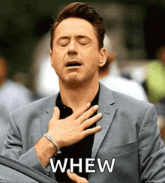
Ge-wiidookaagoyang...
Aaniin apii? | Gaa-izhichigeyaan... Gaa-izhaayaan... | Gaa-miijiyaan...
Gigizheb
Nawakweg
Onaagoshig

Slide 6
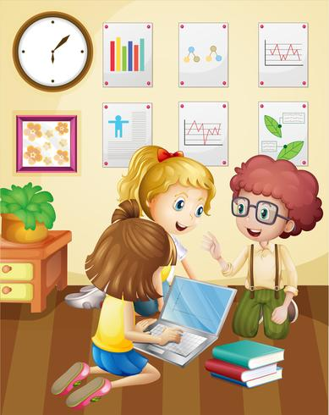
Nenisoobidaa!
Wiindamaadidaa gaa-izhichigeyang bijiinaago. Miinawaa dash igo gaye gidaa-wiindamaadimin akina gegoo gaa-miijiyang bijiinaago. Dibishkoo go yo'ow:
"Bijiinaago gaapanjigan ingii-miijin gigizheb. Mii dash gii-izhaayaan indoozhibii'igewigamigong. Ingii-anokii gabe-gigizheb. Gii-naawakweg idash, nabonigan ingii-amwaa iwidi Subway gaa-ondinigaazod. Gaa-ishkwaa-anokiiyaan, ingii-kiiwe gaa-izhi-naboobiikeyaan. Mashkodesimininaboob ingii-miijin. Ingii-pooboogidingwaaminaadog gabe-dibik. Mii iw."

